Slide 1
MFCC for Music Modeling
Brief summary of the paper
  Goals, algorithms, conclusions
Introduction on some key concepts in DSP
  Sampling, FT, DFT, loudness, dB
  Frequency vs pitch, mel-scal
Literature review, Motivation
Go through paper in detail

Slide 2
Paper Summary
Examine the effectiveness of using MFCCs to model music
  Mel-scale is "at least not harmful" for speech/music classification
  More tests needed to show if the above is due to better modeling for speech or for music, or both
Examine the use of DCT to decorrelate the Mel-spectral vectors
  Effectively reduces dimensions in data
  A good approximation of PCA, or KL-transform
  Similarity in decorrelated vectors for speech and music (cosine waves as basis functions)

Slide 3
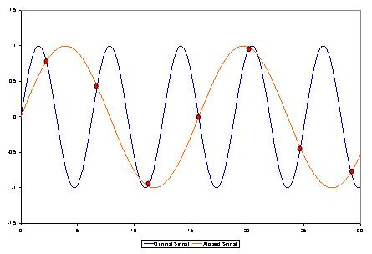
Some Concepts
Sampling, discrete signals
  Sound waves = continuous signals
  Digital signal = discrete signals
  Aliasing: If a sampler is only reading in values at particular times, it can become confused if the input frequency is too fast.
  Nyquist frequency:
    2 x the highest
    frequency of
    the input signal.
    Why 44kHz: human can
    hear 20 Hz to 20 kHz

Slide 4


Some Concepts
dB: unit for intensity of sound
  Intensity proportional to distance^(-2)
  where Pref is the reference sound pressure and Prms is the rms sound pressure being measured
  Jack hammer at 1 m 2 Pa 100 dB
  Leaves rustling, calm breathing 10 dB
  Auditory threshold at 1 kHz 0 dB

Slide 5
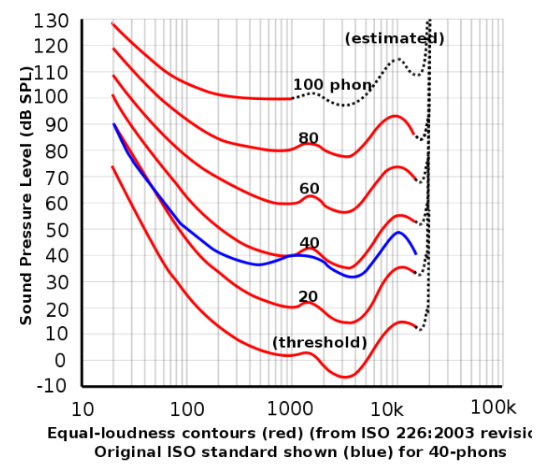
Some Concepts
loudness
  Subjective measure
  Log scaled
A widely used "rule of thumb" for the loudness of a particular sound is that the sound must be increased in intensity by a factor of ten for the sound to be perceived as twice as loud. A common way of stating it is that it takes 10 violins to sound twice as loud as one violin

Slide 6

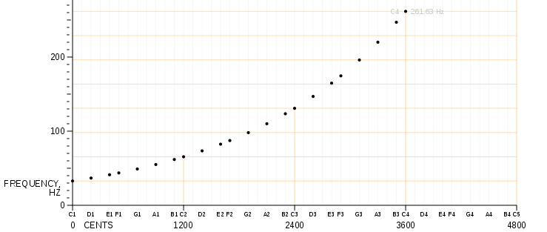
Some Concepts
Frequency vs Pitch
a linear pitch space in which octaves have size 12, semitones (the distance between adjacent keys on the piano keyboard) have size 1, and A440 is assigned the number 69

Slide 7

Some Concepts
Mel-scale
  proposed by Stevens, Volkman and Newman in 1937
  a perceptual scale of pitches
A 1000 Hz tone, 40 dB above the listener's threshold = 1000 mels.

Slide 8
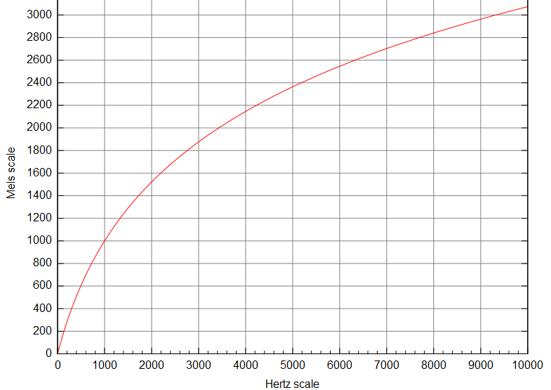
Some Concepts
Mel vs Hz

Slide 9

Some Concepts
Discrete Fourier Transform (DFT)
  Maps time domain function to frequency domain
  The sequence of N complex numbers x0, ..., xN−1 is transformed into the sequence of N complex numbers X0, ..., XN−1 by the DFT according to the formula:
  Number of components = number of signals

Slide 10
Some Concepts
Discrete Fourier Transform (DFT)
  Time domain function = sum of (complex coefficient x wave function)
  Easier to visualize spectral information.
  See demo

Slide 11
Some Concepts
DFT demo
  2 known sine waves
  y=sine_1+sine_2+noise(std normal)
  Use FFT to recover the frequency of the 2 sine waves.

Slide 12
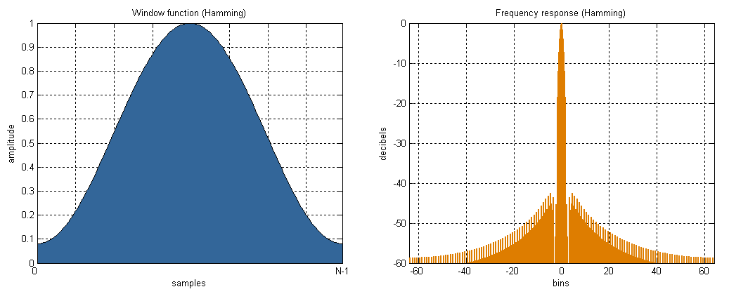
Some Concepts
Hamming Window
  DFT Assumes input signals form exactly one period
  wavelength that do not divide the frame size appear in DFT. This error can be reduced by multiplying the signals by a Hamming window

Slide 13
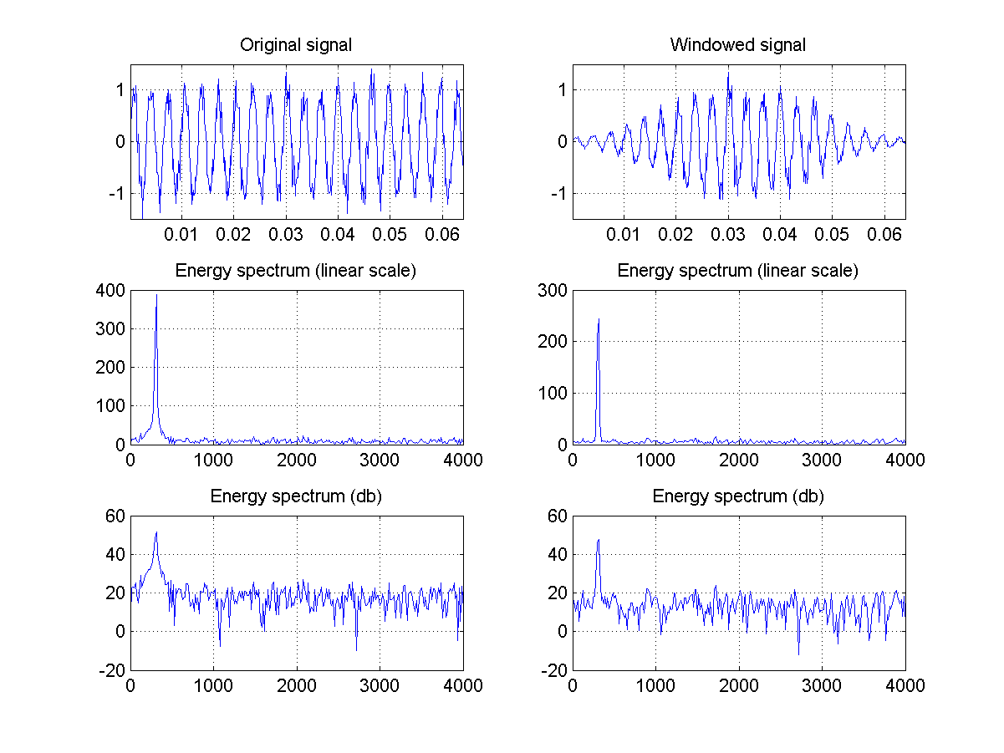

Slide 14
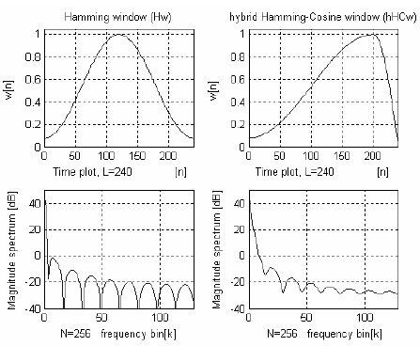
from:
ROBUST MFCC FEATURE EXTRACTION ALGORITHM USING EFFICIENT. ADDITIVE AND CONVOLUTIONAL NOISE REDUCTION PROCEDURES.
-Bojan Kotnik, Damjan Vlaj, Zdravko Kačič,

Slide 15
Relevant Work and Motivation
Keith Martin et el 1998: Music Content Analysis through Models of Audition
  Conventional music-analysis systems relies notes, chords, rhythm and harmonic progressions. So far, not very successful
  Calls for a change in direction: focus on how non-musicians listen to music, turn to psychoacoustics and auditory scene analysis (perception) and DSP
  Case studies:
    speech/music discrimination (identified useful features)
    Acoustic beat and tempo tracking
    Timbre classification
    Music perception systems (make machines judge music like an untrained listener)

Slide 16
Relevant Work and Motivation
Scheirer, Slaney 1997: Construction and evaluation of a robust multifeature speech/music discriminator
  A real-time computer system to distinguish speech vs music
  Use frame-by-frame data
  13 features: 5 of which are VARIANCE features
    Measure how fast a feature changes among 1 second frames
    Others include: spectral centroid, zero-crossing rate etc
  Use Gaussian mixture models and MAP for classification
  High accuracy

Slide 17
Relevant Work and Motivation
Martin 199: Toward automatic sound source recognition: identifying musical instruments
  Experiment based on a set of orchestral musical instruments
  Use frame-by-frame data
  Features: pitch, frequency modulation,spectral centroid, intensity, spectral envelope...
  Log-lag Correlogram is a good representation that encodes most of the features' information

Slide 18
Relevant Work and Motivation
Foote, 1997: Content based retrieval of music and audio
  One of the first to retrieve audio docs by acoustic similarity
  Does not depend on subjective features: brightness, pitch...
  Data driven, statistical methods vs matching audio characteristics
  Inexpensive in computation and storage.
  Use MFCCs to represent audio files
  Supervised tree-based quantizer (decision trees?)
  Experiments:
    Retrieve simple sounds: laughter, thunder, animal cries...
    Retrieve sounds from a corpus of musical clips.
    Supervised cosine distance performed best for both

Slide 19
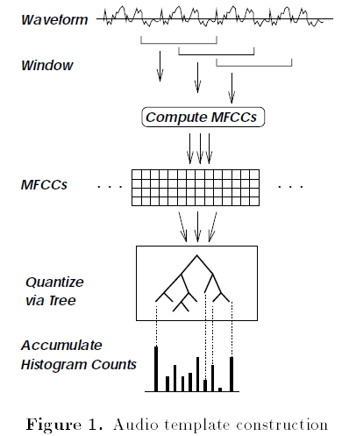
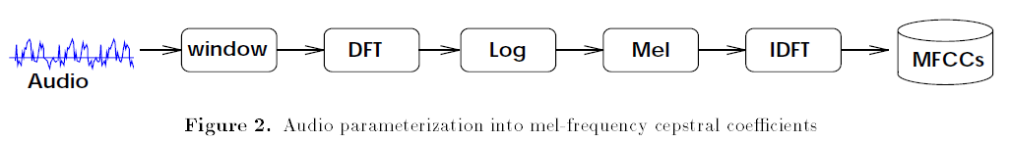

Slide 20
MFCC features
MFCC feature extraction
  Divide signal into frames (~20ms)
  Discrete Fourier Transform (DFT)
  Take the log of amplitude spectrum (pull up)
  Mel-scaling and smoothing (pull to right)
  Discrete Cosine Transform (DCT)
  Obtain MFCC features
Each frame of signals in time domain will be represented/encoded by a vector of 13 features

Slide 21
MFCC features
Demo, ma_mfcc(wav, p), MA TOOLBOX
INPUT
wav (vector) obtained from wavread or ma_mp3read
(use mono input! 11kHz recommended)
p (struct) parameters e.g.
p.fs = 11025; %% sampling frequency of given wav (unit: Hz)
* p.visu = 0; %% create some figures
* p.fft_size = 256; %% (unit: samples) 256 are about 23ms @ 11kHz
* p.hopsize = 128; %% (unit: samples) aka overlap
* p.num_ceps_coeffs = 20;
* p.use_first_coeff = 1; %% aka 0th coefficient (contains information
%% on average loudness)
* p.mel_filt_bank = 'auditory-toolbox';
%% mel filter bank choice
%% {'auditory-toolbox' | [f_min f_max num_bands]}
%% e.g. [20 16000 40], (default)
%% note: auditory-toobox is optimized for
%% speech (133Hz...6.9kHz)
* p.dB_max = 96; %% max dB of input wav (for 16 bit input 96dB is SPL)

Slide 22
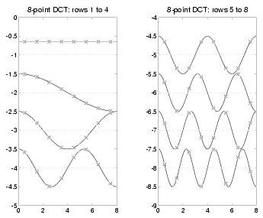
MFCC features
Cosine basis functions:

Slide 23
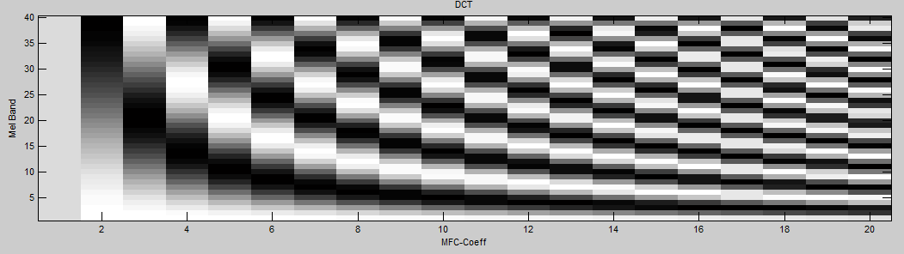
MFCC features
Basis functions in the graph:
White-black = half a cycle
1: no cycle. 2: half cycle. 3: 1 cycle etc.
Normally use 13 coefficients.

Slide 24
MFCC features
Questions?
Strengths?
Weaknesses?

Slide 25
MFCC features
Natural to use the mel-scale and log amplitude since it relates to how we perceive sounds
Model small (20ms) windows that are statistically stationary
Assumption: phase info is less important than amplitude
DFT assumes each frame of signals here is exactly one period

Slide 26
Mel vs Linear
via Speech/Music classification
  2hr training data and 40min testing data
  Music: 10% in train, 14% in test
  Bag of frames => Bunch of feature vectors per song
  EM algorithm to train Gaussian classifiers
  Compare likelyhood of a new point X:
    P(X|music) vs P(X|speech), choose max

Slide 27
Mel vs Linear
Speech and music modeled using GMM
Both Mel-ed and linear features are 13 dimensional:
  Mel: 40 bins-->DCT-->13 features
  Linear: 256 bin-->DCT-->13 features
In training data, speech frames and music frames are used to train GMM for speech and music respectively, via EM algorithm

Slide 28
EM algorithm
expectation-maximization (EM) algorithm is used for finding maximum likelihood estimates of parameters in probabilistic models, where the model depends on unobserved latent variables.
expectation (E) step: compute an expectation of the log likelihood with respect to the current estimate of the distribution for the latent variables
maximization (M) step: compute the parameters which maximize the expected log likelihood found on the E step.
These parameters are then used to determine the distribution of the latent variables in the next E step.
http://upload.wikimedia.org/wikipedia/commons/a/a7/Em_old_faithful.gif

Slide 29
Mel vs Linear
speech/music discriminator
  GMM in 13-D space
  Given a new data point to predict, find:
    P(x|X~speech_1), P(x|X~speech_2), ...
    P(x|X~music_1), P(x|X~music_2), ...
    Find P(x|speech) and P(x|music) by summing products of coefficients and P(x|X~some model)
  X belongs to Y if Y = argmax P(x|X~Y), Y=speech or music

Slide 30
Mel vs Linear
Questions?
Strengths?
weaknesses?

Slide 31
Mel vs Linear
Use of well-algorithms, GMM, EM
Consider avg likelihood over a test segment (many frames) – but how long is appropriate for a segment?
Explanation in paragraph 2 was very confusing
How is segmentation error computed? (table 1)

Slide 32
DCT to approximate PCA
Known: KL decorrelates speech data
Try:
  DCT to decorrelate speech data
  DCT to decorrelate music data
Results:
  Similarity in basis functions for speech and data

Slide 33
DCT and PCA
DCT: breaks function into sum of cosine basis functions
PCA is a common technique to find patterns in data of high dimension, used in face recognition, image compression, etc.
PCA transforms a number of possibly correlated variables into a smaller number of uncorrelated variables called principal components.
Reduces dimensions

Slide 34
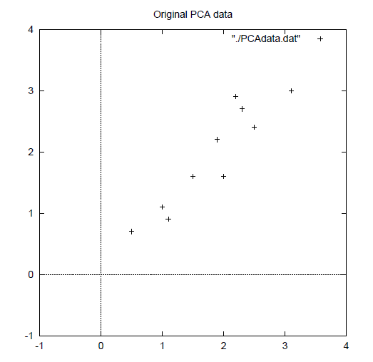
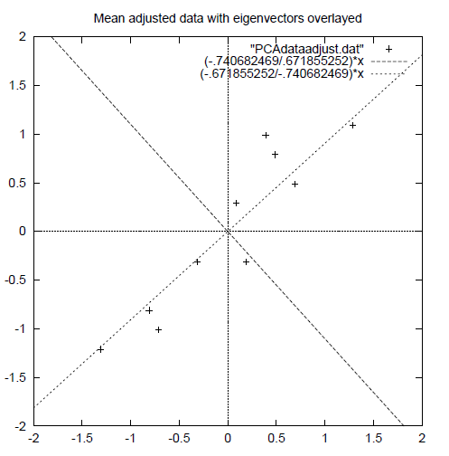
PCA
Start with LINEARLY correlated data
Adjust to mean
Find eigenvectors of the covariance matrix

Slide 35
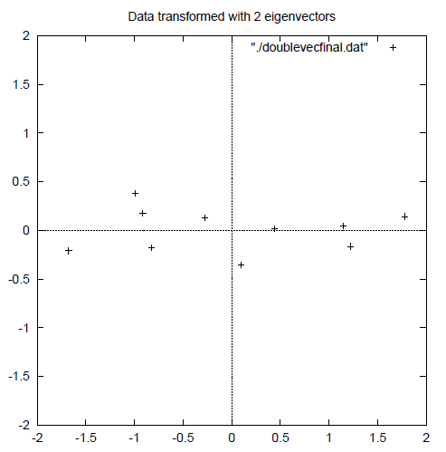
PCA
Eigenvector with the highest eigenvalue is the principal component: accounts for most of the variation in the data
Translate to new
coordinates
If original data is
MultiVarGaussian,
then we obtain
a singleVar distribution

Slide 36
DCT and PCA
c=Du
  u is of higher dimension, DFT coefficients?
  c=MFCC features, column vector
  Each row in D is a set of cosine basis functions
    Analogous to orthanormalized eigenvectors in O?

Slide 37
DCT and PCA
For speech data:
  KL transform gives 'cos-like' basis functions
  Thus DCT approximates PCA in speech data
For music data:
  KL transform gives 'cos-like' basis functions
  Thus DCT approximates PCA in music data as well
Questions?
Strengths?
Weaknesses?

